Slide 1


Doctor-Patient Portal

Slide 2
Overview
Requirements Workflow
Analysis Workflow
Structured System Analysis
Design Workflow
Implementation
Testing

Slide 3
Requirements Workflow
Doctor Patient Portal
We here propose a doctor patient handling, managing system that helps doctors in their work and also patients to book doctor appointments and view medical progress. The system allows doctors to manage their booking slots online. Patients are allowed to book empty slots online and those slots are reserved in their name. The system manages the appointment data for multiple doctors for various date and times. Each time a user visits a doctor his/her medical entry is stored in the database by doctor. Next time a user logs in he may view his/her entire medical history as and when needed. At the same time a doctor may view patients medical history even bore the patient visits him. This allows for an automated patient doctor handling system through an online interface. Our system also consists of organ donor module. This module allows for organ donation registration as well as organ search. The module is designed to help urgent organ requirements through easy/instant searches.

Slide 4
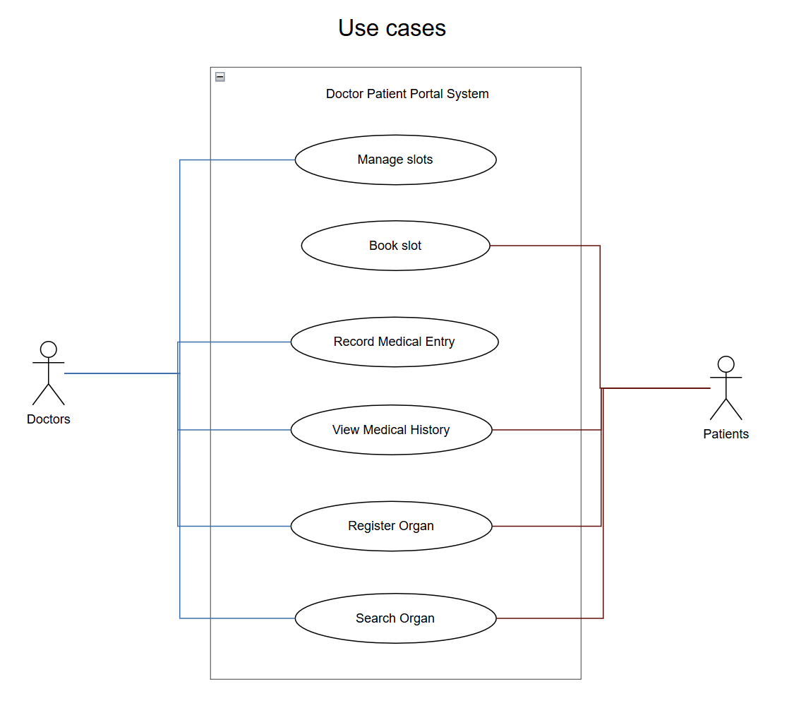
Use Case Diagram

Slide 5
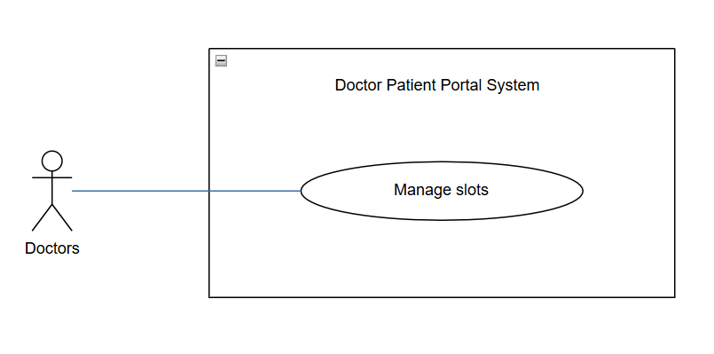
Preconditions:
- The doctor must be logged into their account on the portal.
- The patient must have an existing account in the system
Steps:
1. The doctor logs into the portal using valid credentials.
2. The doctor navigates to the “Record Medical Entry” section.
3. The system displays a list of patients and their existing medical histories.
4. The doctor searches for the specific patient.
5. The system displays the selected patient’s current medical records.
6. The doctor fills out the new entry form with updated medical details.
7. The doctor reviews and confirms the entry, then submits it.
8. The system updates the patient’s medical record and stores the new entry in the database.
Description:
The objective of this use case is to allow the doctor to manage their booking slot. They will be able to view all the appointment and take actions such as confirming, rescheduling the patient or make an unavailable slots.

Slide 6
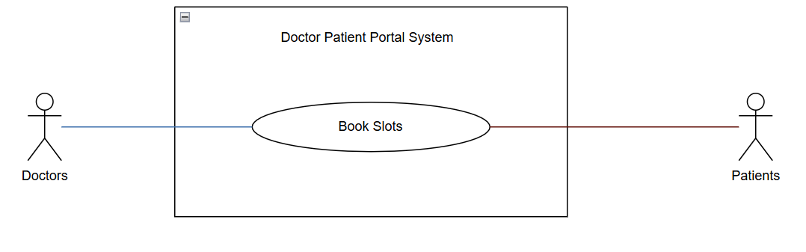
Preconditions:
- The patients must be logged into their account on the portal
- There must be at least an empty slot
Steps:
1. The patient logs into the system and selects the “Book Slots” option from the main menu.
2. The system displays a booking form.
3 The patient selects a preferred date to view available time slots.
4. The system displays all available doctors and slots for that date.
5. The patient chooses their preferred doctor and slot.
6. The patient confirms the booking and submits the form.
7. The system reserves the slot under the patient’s name and updates the appointment database
Description:
The objective of this use case is to allow patients to book available appointment slots with doctors. Once a slot is booked, it is reserved in the patient’s name and the appointment details (date, time, and doctor) are stored in the system.

Slide 7
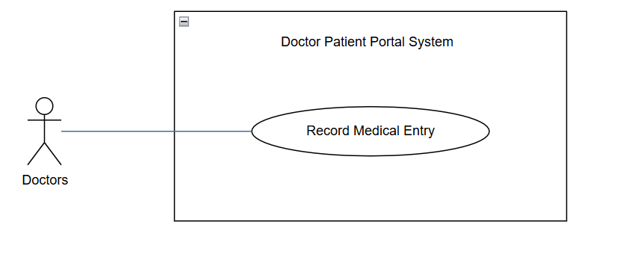
Preconditions:
Doctor must be logged into their account on the portal
The system must already have patient bookings or open slots available
Steps:
1. Doctors will access the portal with their credentials
2. Doctors browses to "Manage slots" section
3. The system display all the past, current and upcoming slots
4. The doctors review booked slots and select one of the following action:
- Confirm patient appointment
- Reschedule it
- Mark a slot unavailable
5. The system updates the booking and notify the patient.
Description:
The objective of this use case is to allow doctors to record and update a patient’s medical information after a consultation. The doctor can enter details such as diagnosis, prescriptions, and treatment notes, which are stored in the system for future reference.

Slide 8
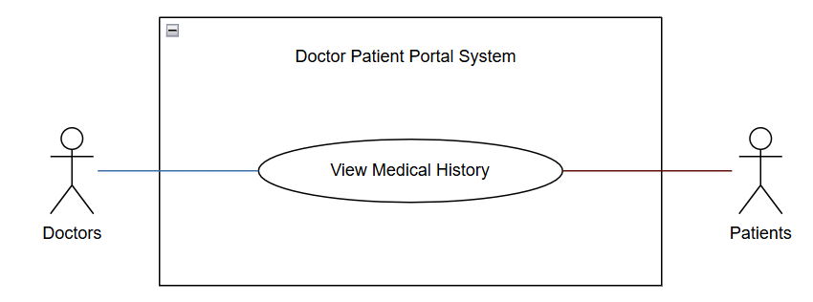
Preconditions:
- The doctor must be logged into their account on the portal.
- The patient must have an existing account in the system
Steps:
1. The doctor or patient logs into the portal using valid credentials.
2. The system displays the main menu options.
3. The doctor or patient navigates to the “View Medical History” section.
4. The doctor searches for a patient using the search bar, while the patient directly accesses their own medical history.
5. The system displays a list of medical records associated with the patient.
6. The doctor or patient selects a specific record to view details.
7. The system displays the complete record, including visit date, attending doctor, diagnosis, and treatment details.
8. The doctor or patient can choose to print or email the record if needed.
Description:
The objective of this use case is to allow doctors and patients to view a patient’s medical history. Doctors have full access to the patient’s records, while patients have limited access to their own information. The system displays details such as visit date, doctor’s name, diagnosis, prescribed medications, and other relevant notes.

Slide 9
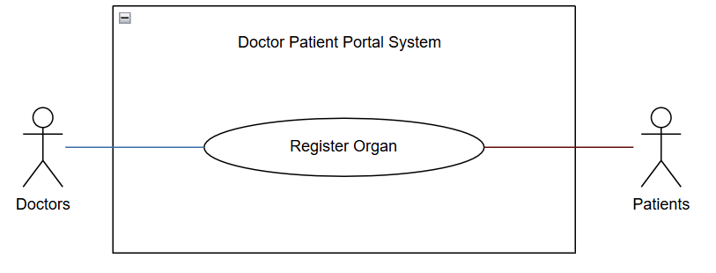
Preconditions:
- The doctor must be logged into their account on the portal.
- The user must provide valid personal and medical information for registration.
Steps:
1. The doctor or patient logs into the portal using valid credentials.
2. The user navigates to the “Organ Donation” or “Register Organ” section.
3. The system displays an organ registration form.
4. The user fills in the required details, including organ type, medical compatibility, and contact information.
5. The user reviews and confirms the entered information.
6. The user submits the form for registration.
7. The system validates the details and stores the record in the organ donor database.
8. A confirmation message is displayed to the user indicating successful registration.
Description:
The objective of this use case is to allow doctors or patients to register for organ donation within the system. The user provides details such as organ type, blood group, contact information, and consent for donation. The information is stored securely in the organ donor database to assist in future organ searches or matches.

Slide 10
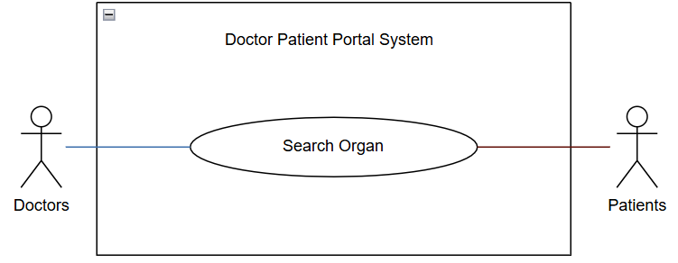
Preconditions:
- The doctor must be logged into their account on the portal.
The system must contain registered organ donor information.
Steps:
1. The doctor or patient logs into the portal using valid credentials.
2. The user navigates to the “Search Organ” section.
3. The system displays a search form with filters such as organ type, blood group, and location.
4. The user enters the desired search criteria and submits the request.
5. The system searches the organ donor database for matches.
6. The system displays a list of matching donors with key details (e.g., organ type, availability, and contact information).
7. The doctor or patient can select a specific donor record to view more details.
8. The system displays complete donor information as permitted by privacy and system rules.
Description:
The objective of this use case is to allow doctors and patients to search for available organ donors in the system. The user can search based on organ type, blood group, and location. The system retrieves and displays matching donor records to help fulfill urgent organ requirements quickly and efficiently.

Slide 11
Analysis Workflow
Here, we followed the traditional 9 step process for Structured System Analysis.

Slide 12
Classical Analysis: Structed System Analysis
Step 1: Draw the DFD

Slide 13
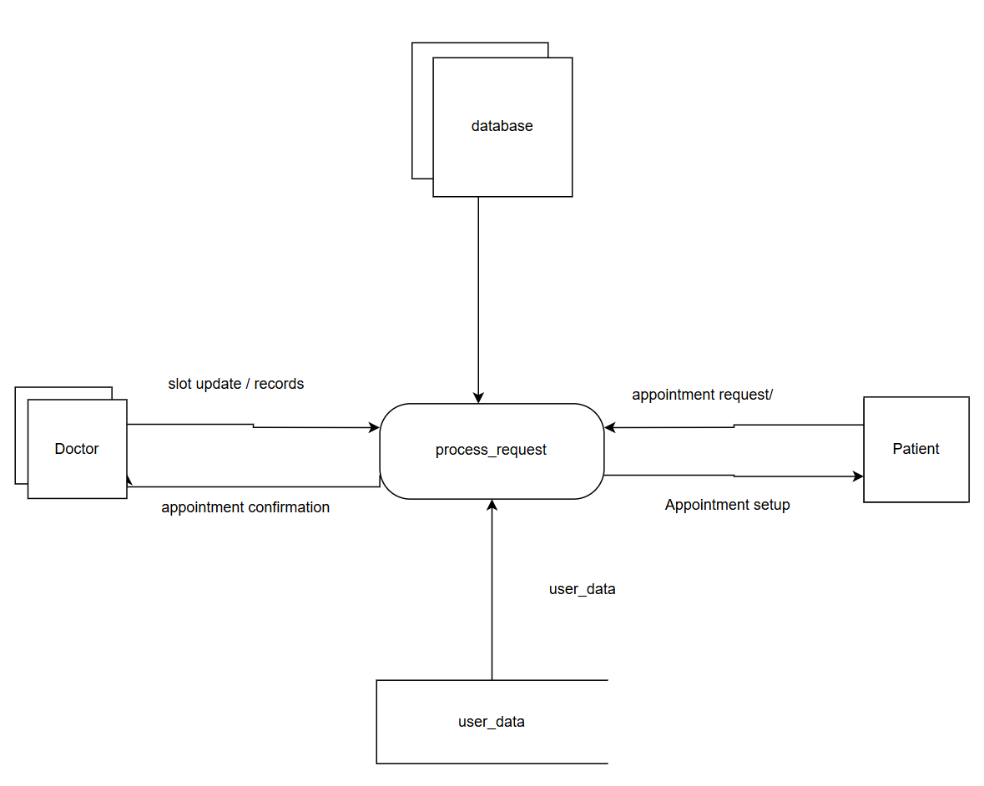
First refinement of DFD
Very rudimentary with only database, user classes, and user_data defined.
All Processes combined into a “request”

Slide 14
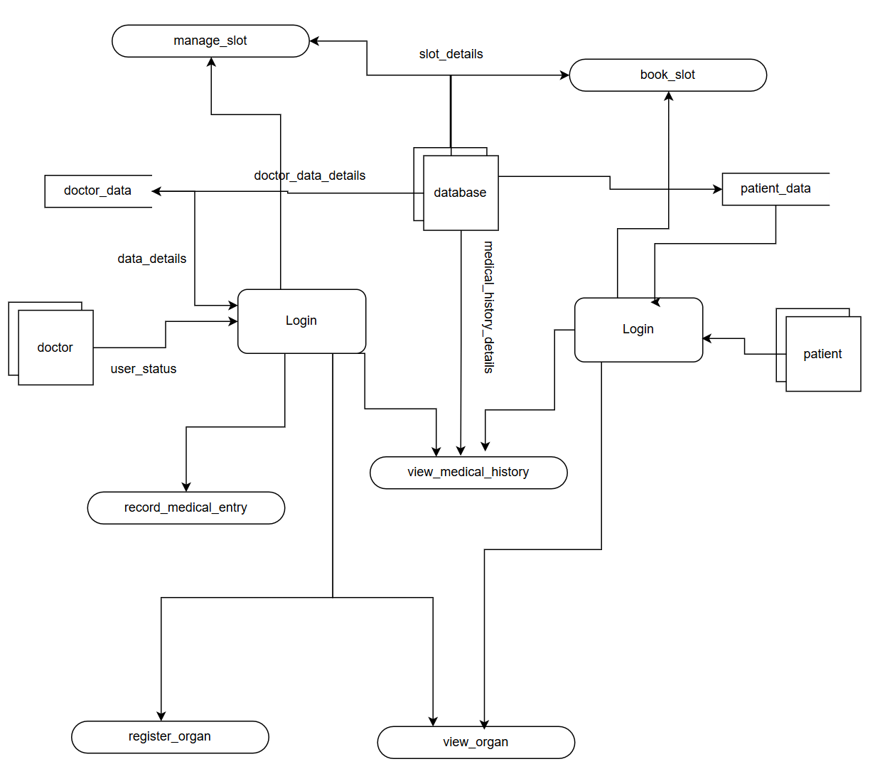
Second refinement of DFD
Many more processes defined
More detailed and numerous variables.

Slide 15
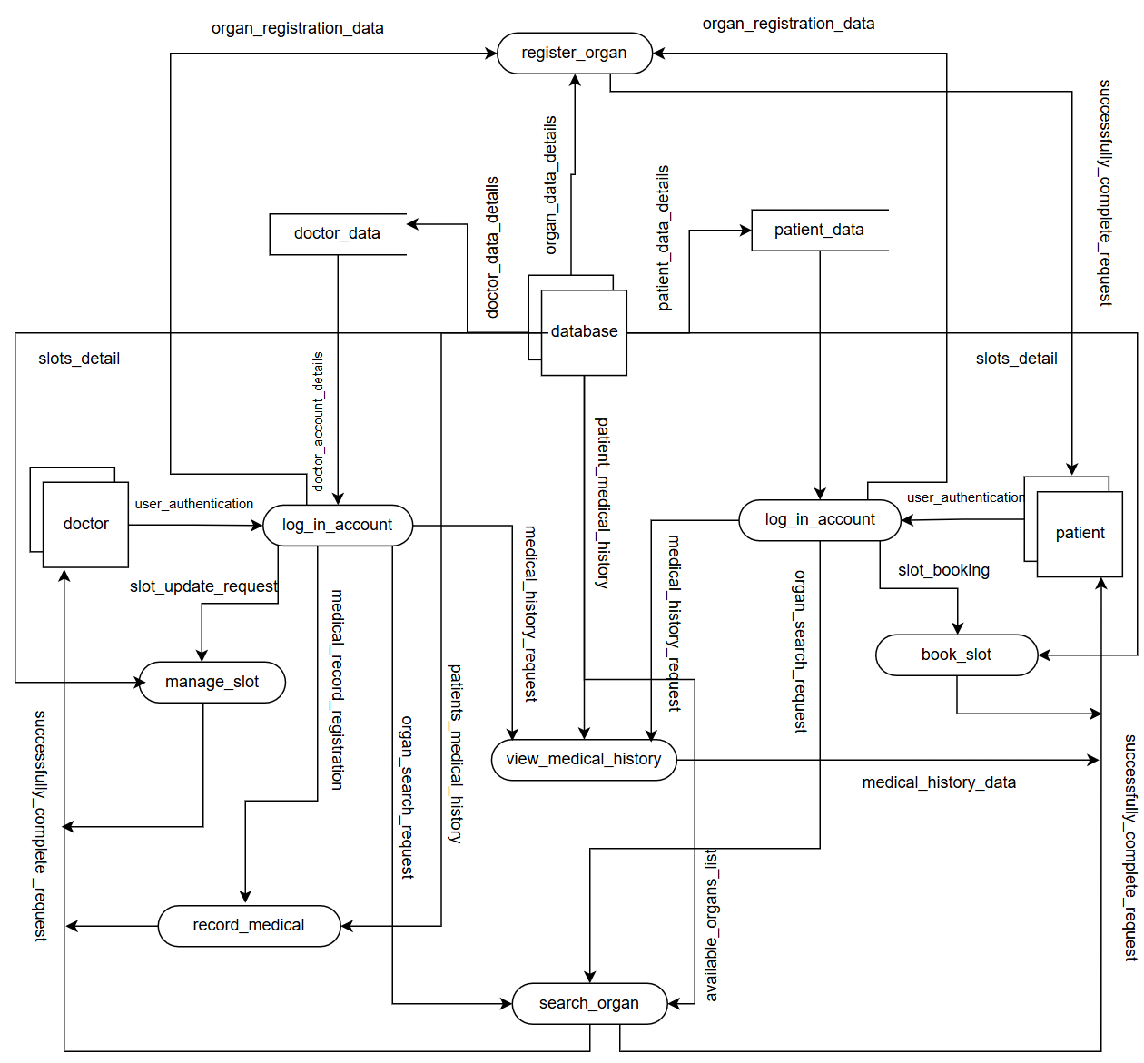
Final refinement of DFD
Closely linked to current software implementation.

Slide 16
Step 2
Determine what parts to computerize

Slide 17
As a school project…
We were ideally not looking for any large-scale implementation, so we will be sticking to free solutions, using a GIT repository to house our code.

Slide 18
Step 3
Put in details of data flows

Slide 19
Appointment Booking Flow
slot_booking:
- slot_id: Long
- doctor_data:
- id: Long
- name: string
- specialty: string
- consultationFee: Double
- patient_data:
- id: Long
- name: string
- phone: string
- appointment_details:
- date: LocalDate
- time: LocalTime
- status: PENDING | CONFIRMED | COMPLETED | CANCELLED
- reason: string
- notes: string
User Authentication & Management
user_authentication :
- email_address : string
password : string
role : string
user_profile:
- id: Long
- name: string
- email: string
- phone: string
- role: string
- active: boolean
- createdAt: LocalDateTime
manage_appointment:
- email_address : string
password : string
role : string

Slide 20
organ_registration
organ_donor_registration:
- donor_id: Long
- personal_details:
- name: string
- age: Integer
- gender: MALE | FEMALE | OTHER
- bloodGroup: string
- contactNumber: string
- email: string
- donation_details:
- organsToDonate: string
- medicalConditions: string
- isActive: boolean
- registrationDate: LocalDate
organ_search_request
- filter
- id: string
- name: string
- date: string
- organ: string
- city: string
- data: organ_data[]

Slide 21
medical_record_flow:
- record_id: Long
- patient_data:
- id: Long
- name: string
- bloodGroup: string
- doctor_data:
- id: Long
- name: string
- specialty: string
- medical_data:
- visitDate: LocalDate
- symptoms: string
- diagnosis: string
- prescription: string
- testResults: string
- vital_signs:
- bloodPressure: string
- temperature: Double
- heartRate: Integer
- weight: Double
view_medical_history
- filter:
- id?: string
name?: string
email?: string
- data: patient_medical_record []
- medical_record_registration
slot_management:
- slot_id: Long
- doctor_details:
- id: Long
- name: string
- specialty: string
- slot_timing:
- slotDate: LocalDate
- slotTime: LocalTime
- durationMinutes: Integer
- availability:
- isAvailable: boolean
slot_booking
- slot_details
- add_slot

Slide 22
Step 4
Define the logic of processes

Slide 23
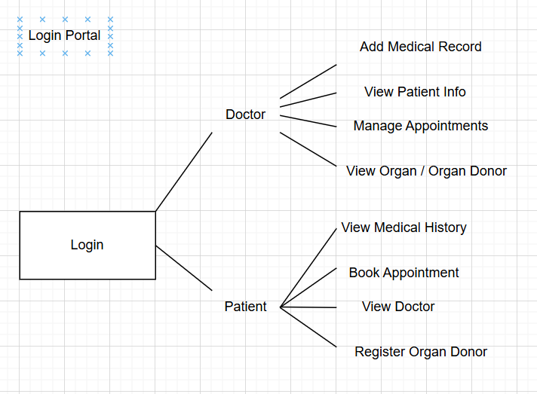
Logic Process of our Login Portal
Login credentials either validate a patient account or doctor account
Based on account, there are different viewing options.

Slide 24
Step 5
Define the Data Storage

Slide 25

Data Storage Solution
We used MySQL

Slide 26
Step 6
Define the Physical Resources

Slide 27
For each File, we specify filename and details
doctor_data
stored_on_disk
store_on_cloud
patient_data
stored_on_disk
store_on_cloud
appointment_data
stored_on_disk
store_on_cloud
organs_list_data
stored_on_disk
store_on_cloud
medical_history_data
stored_on_disk
store_on_cloud

Slide 28
Step 7
Determine Input/Output Specifications

Slide 29
Input Screens are designed for the following:
registerDonor, addRecord, getDoctorById, updateDoctor, login, register, bookAppointment, getAppointmentByDoctor, getAppointmentByPatient.

Slide 30
The following reports are displayed.
Appointment, AvaliableSlot, Doctor, MedicalRecord, OrganDonor, Patient, User

Slide 31
Step 8
Determine the Sizing

Slide 32
The size of the data will matter in this project. Each patient will have a personal information store and medical history as well. The best way to allocate a size to patients is to estimate a number of year. For instance, patients can visit the medical facilite for 30 years. So, We can allocate an avarage of 15MB to patients. In additional a document
Each data storage will be allocated 10MB. In cloud storage like firestore, a document limit is 1MB.

Slide 33
Step 9
Determine Hardware Requirements

Slide 34
- Cloud provider (firebase, AWS, superbase, SQL)
- Computer with windows, preferred macOS for both simulator and emulator

Slide 35
Design Workflow

Slide 36
Working from final DFD
Extracted Module Diagram from this

Slide 37
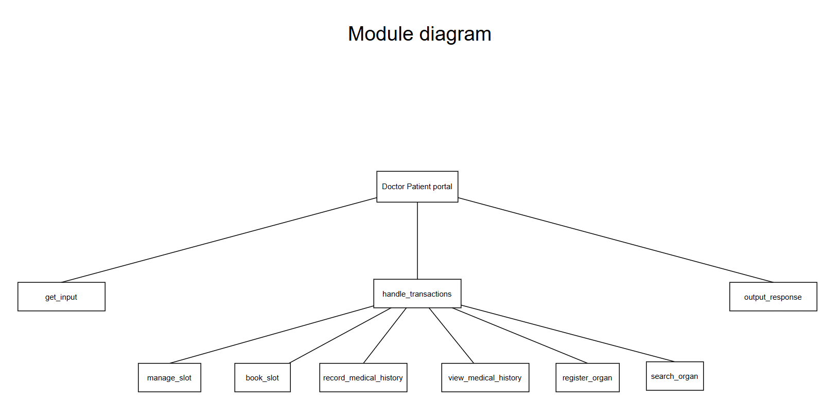
Module Diagram

Slide 38
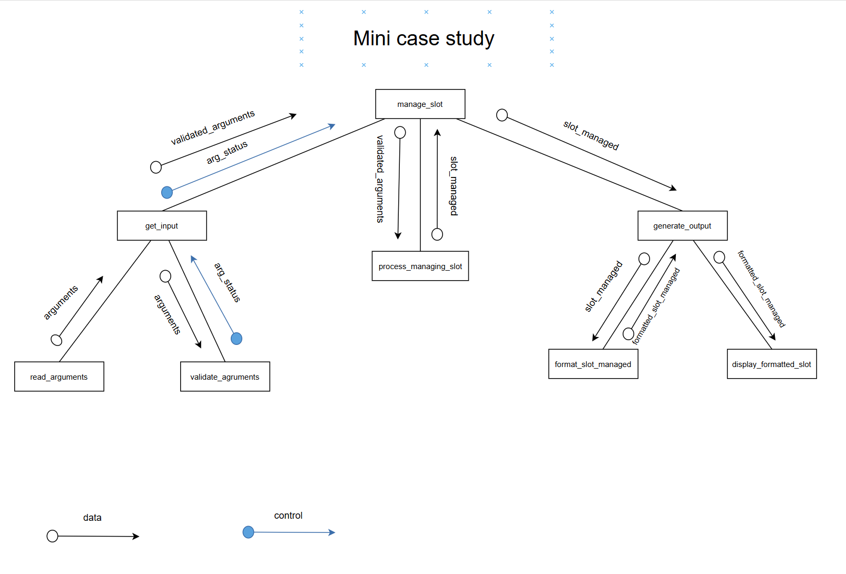
Case Study

Slide 39
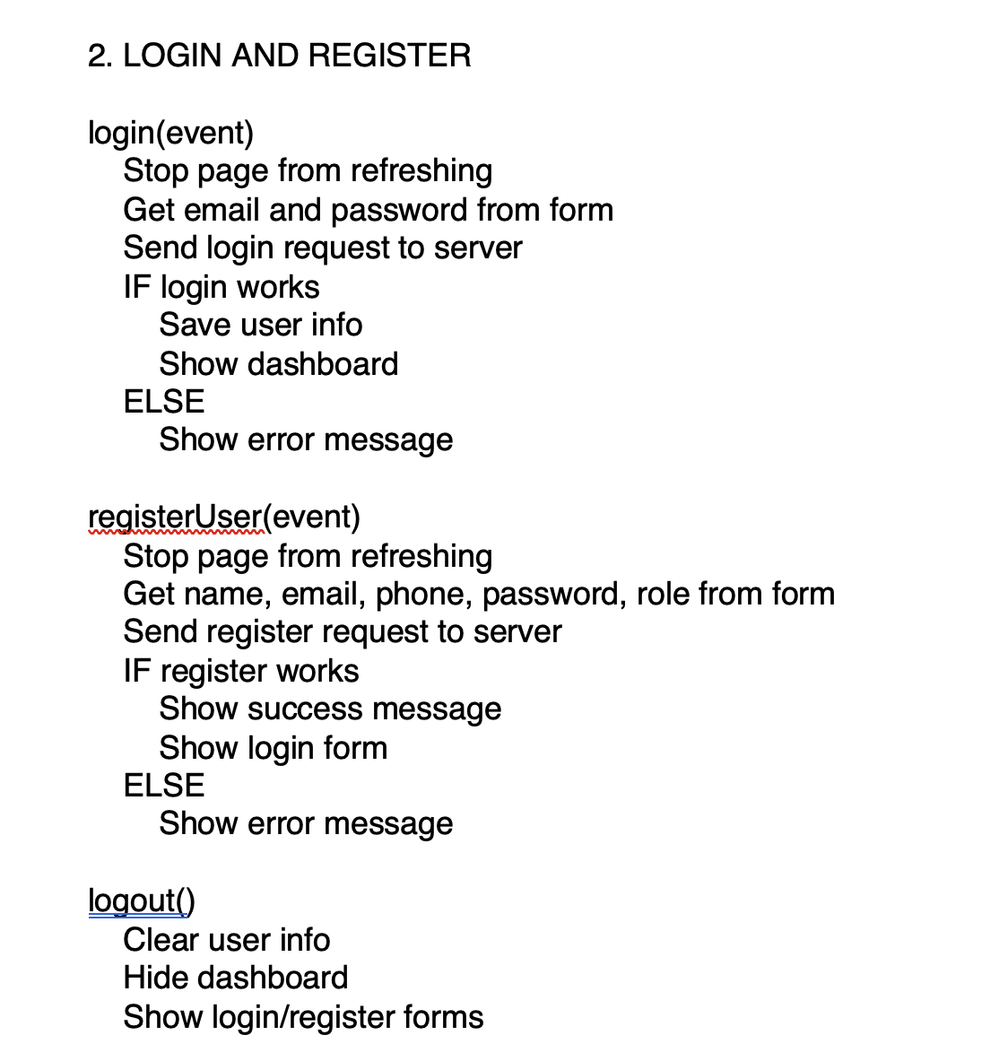
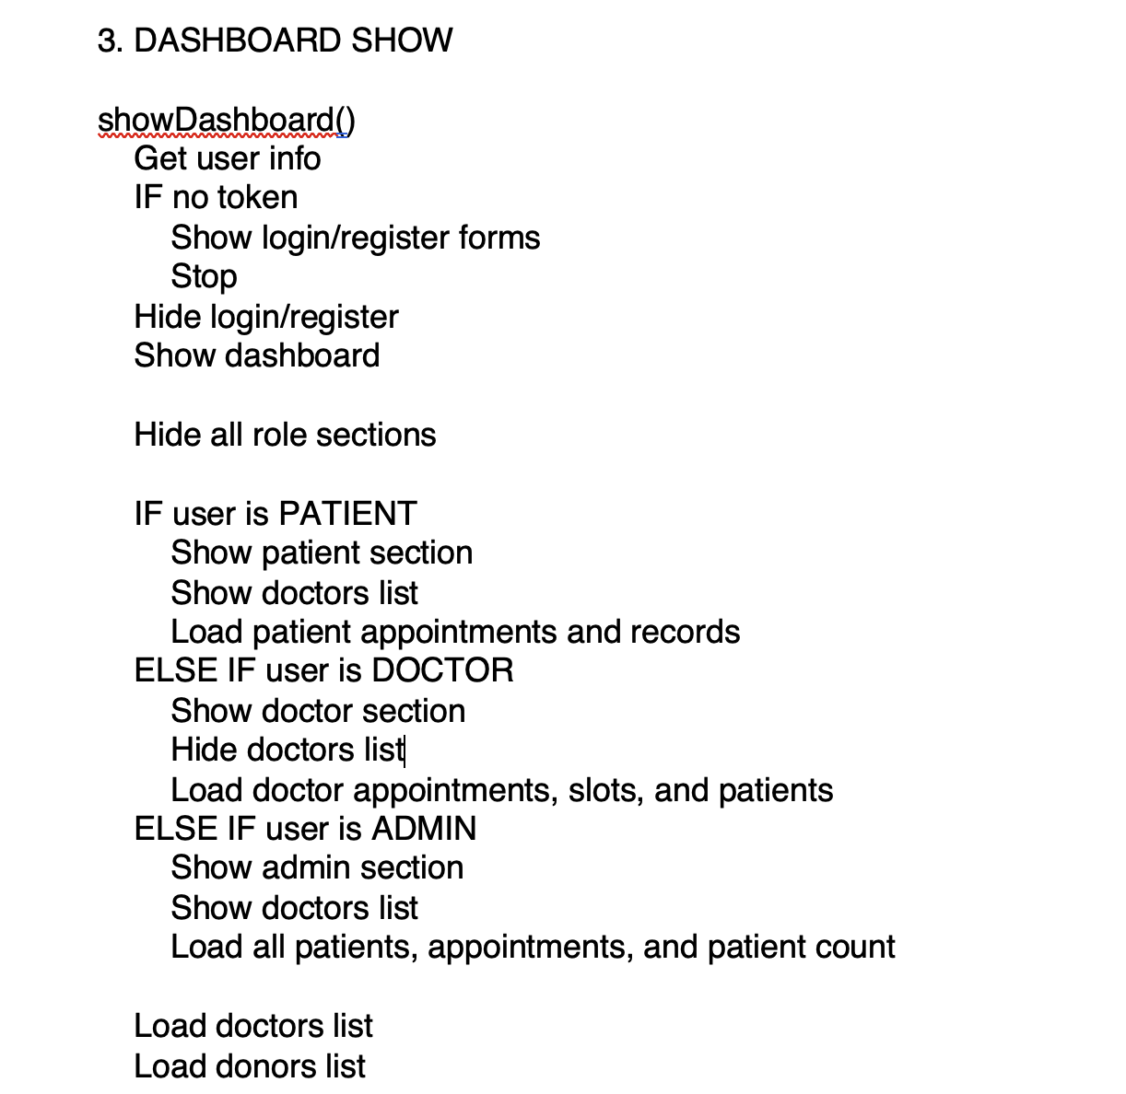
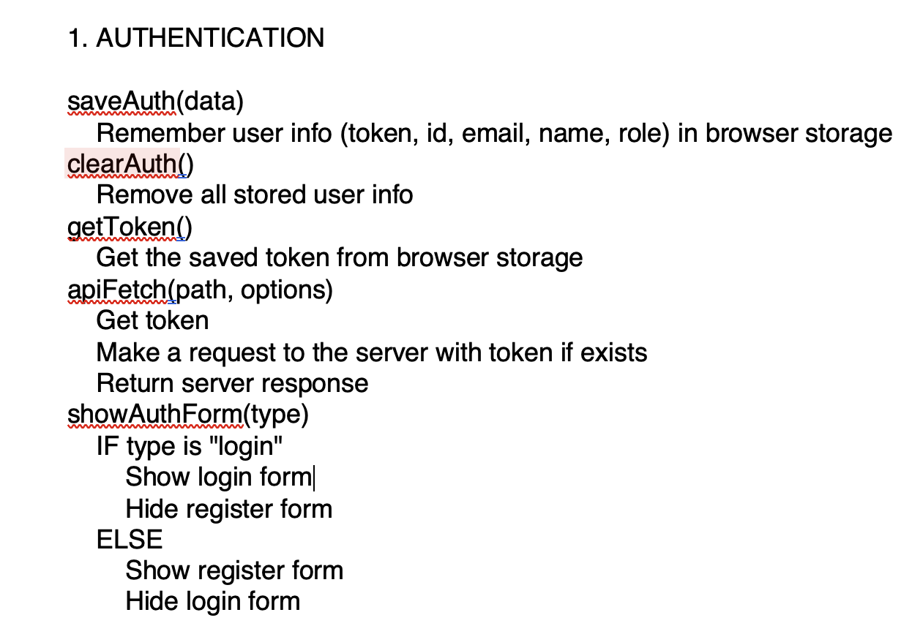
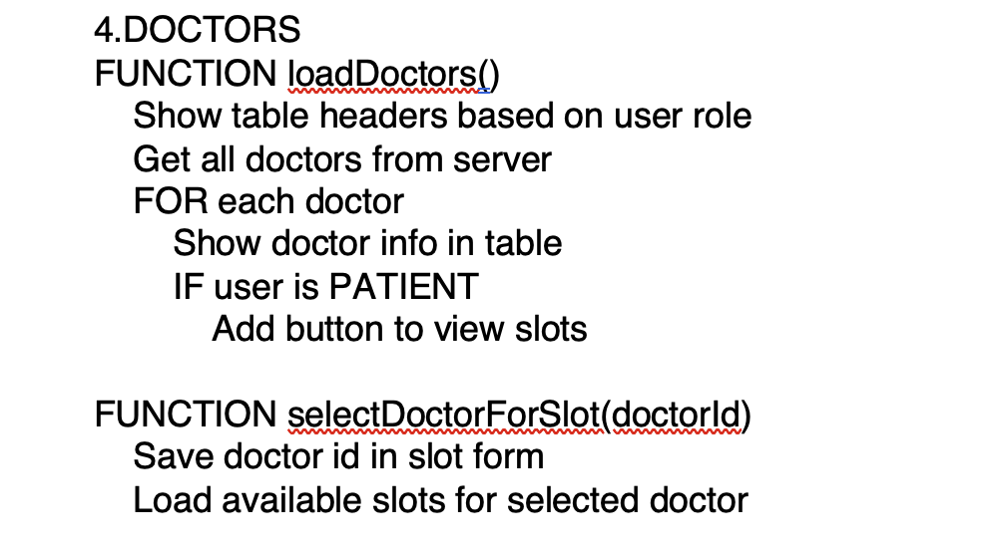
Pseudo Code

Slide 40
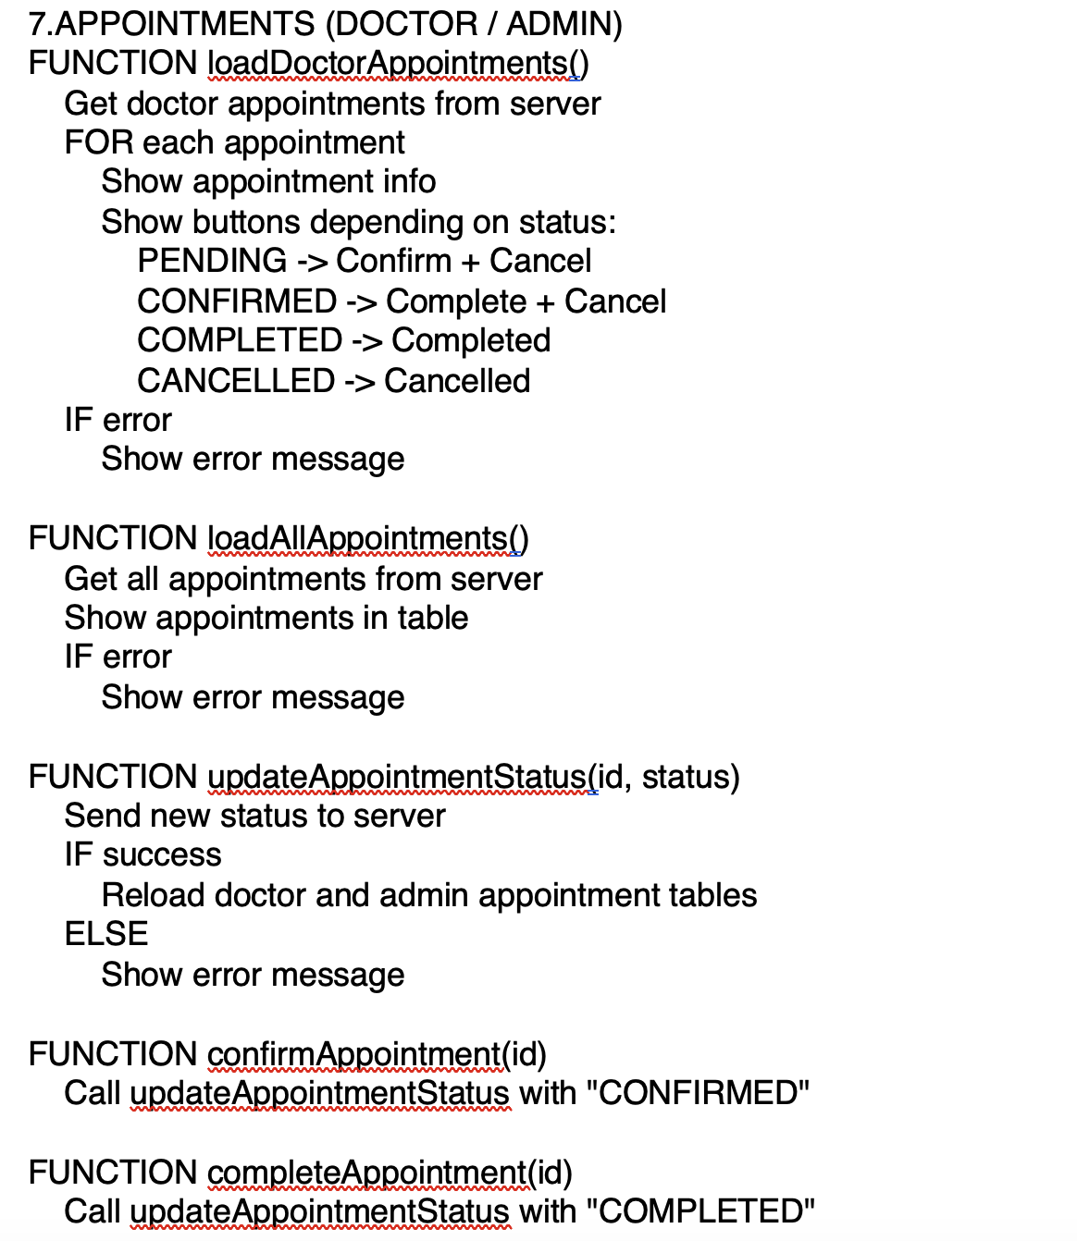
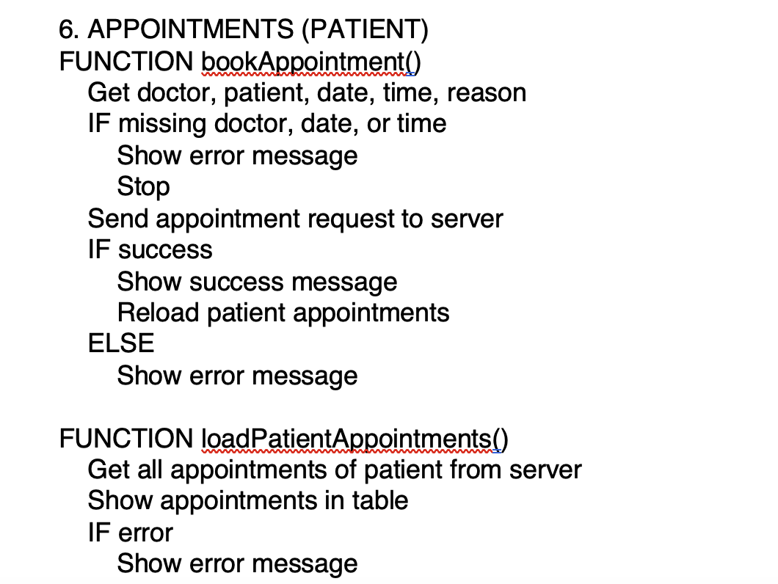
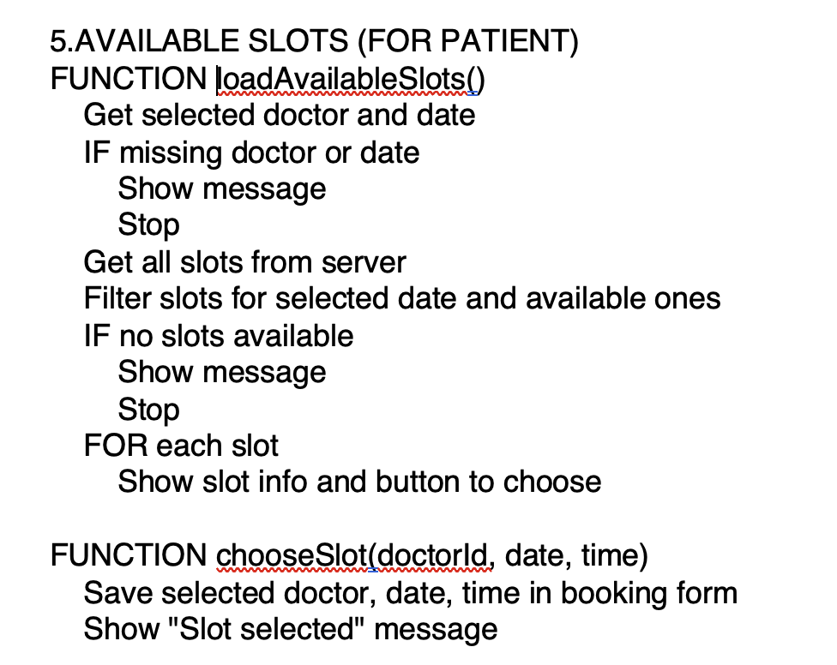
Pseudo Code

Slide 41
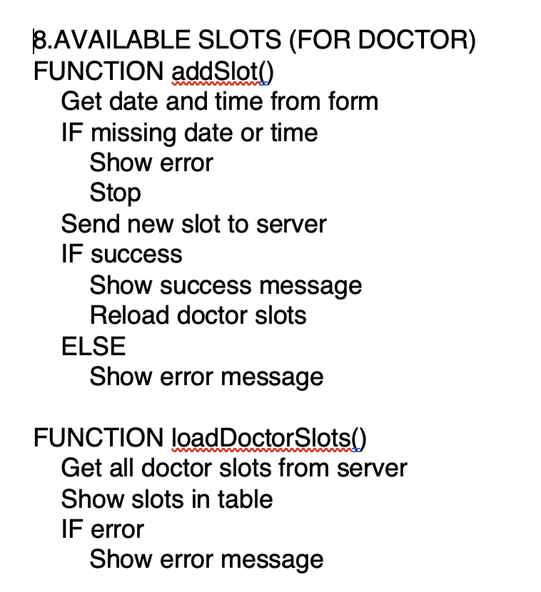
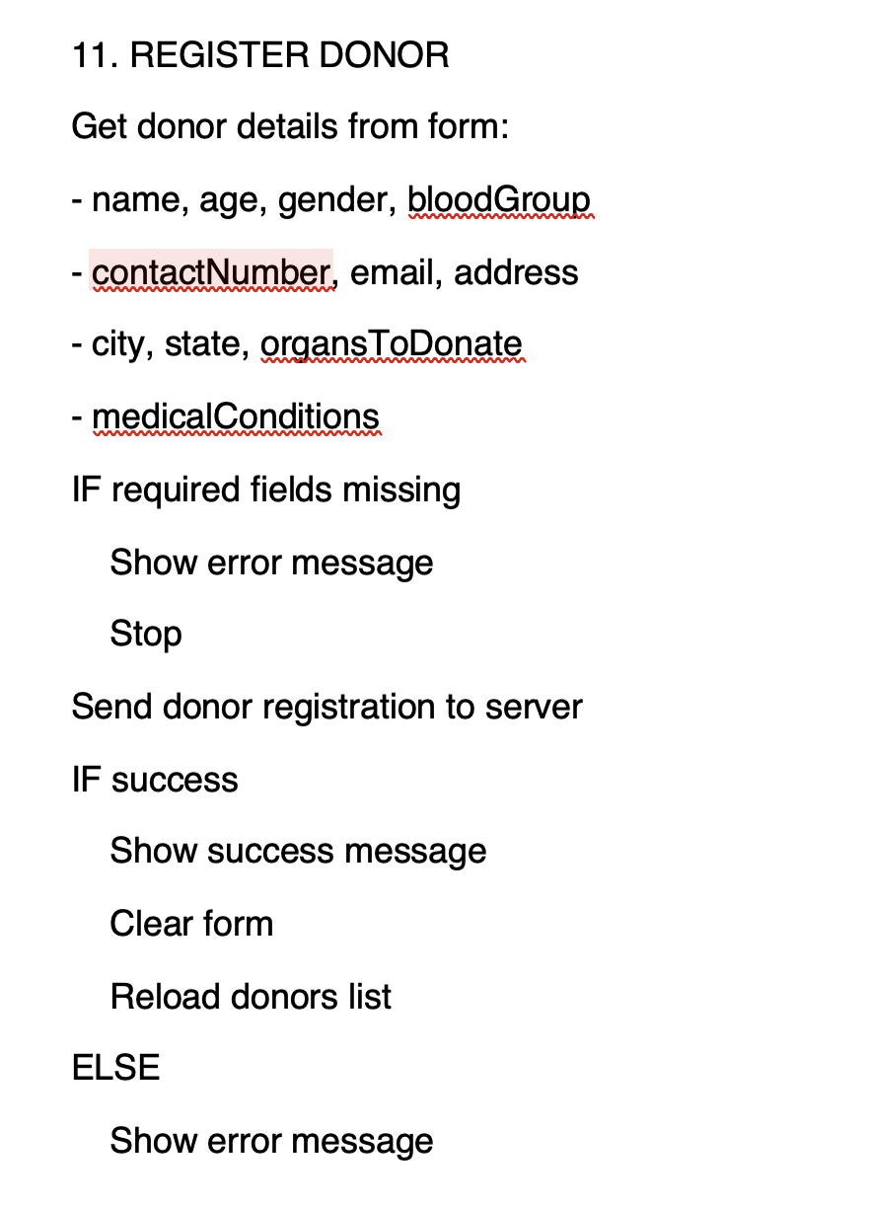
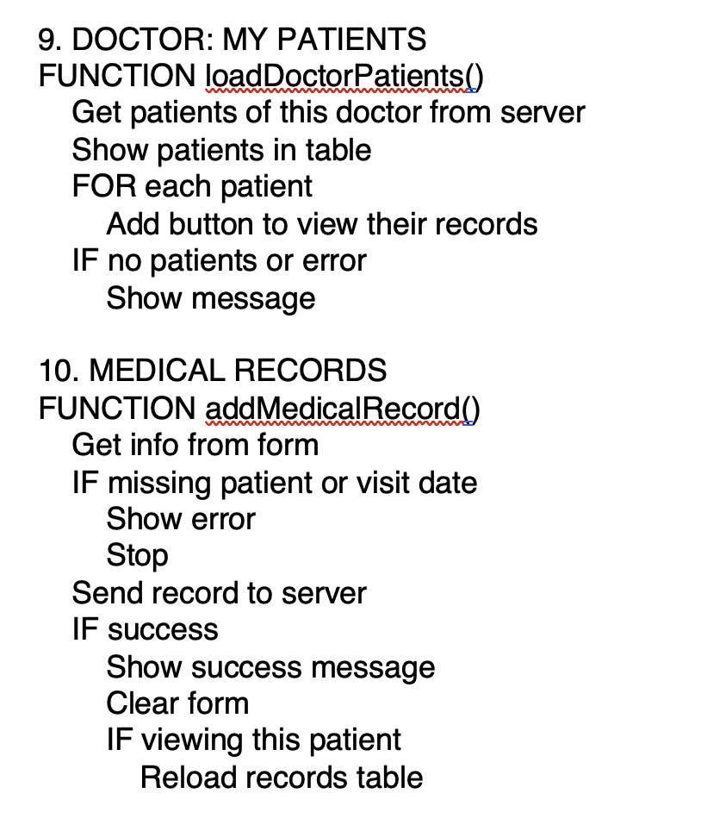
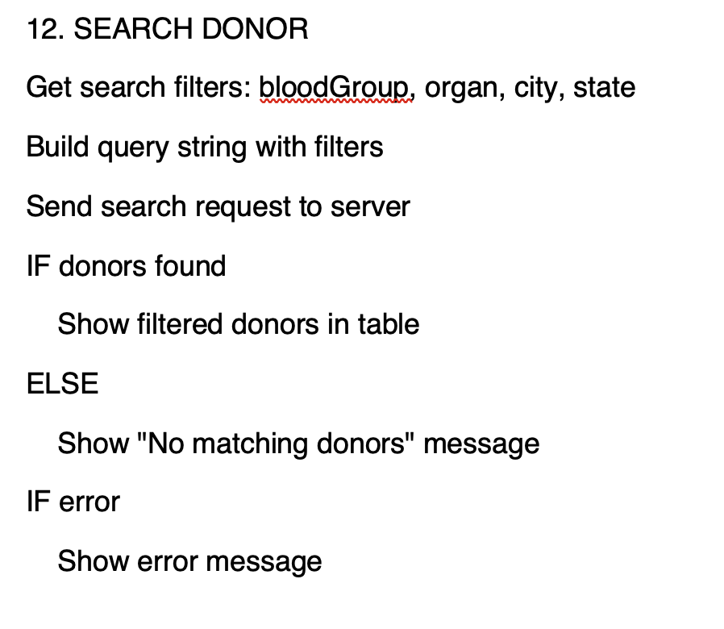
Pseudo Code

Slide 42
Implementation Workflow
Source Code located in GIT repository:
https://github.com/Rajeet10/Doctor-Paitent-Portal-System

Slide 43
Running Results: Snapshots

Slide 44
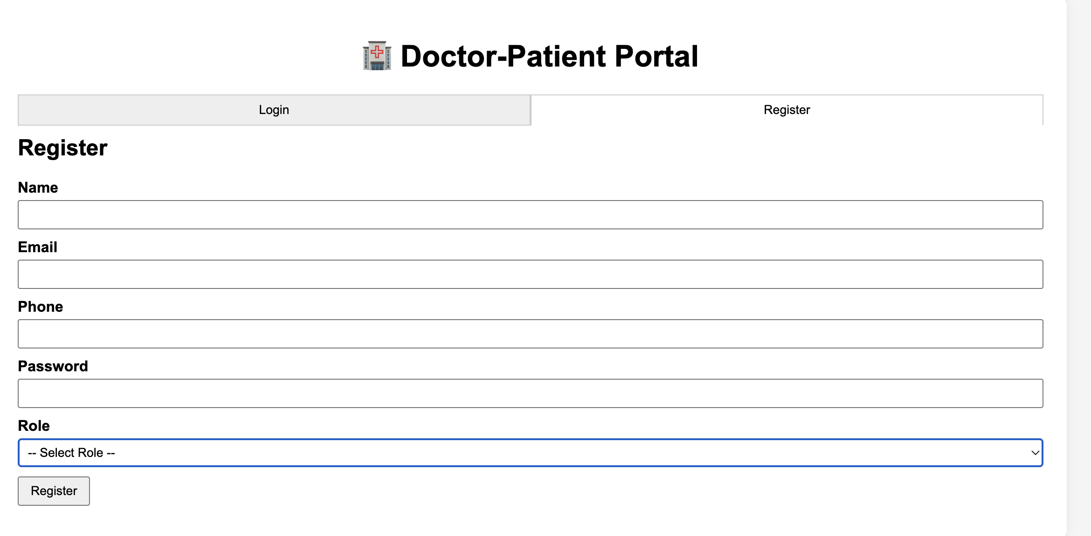
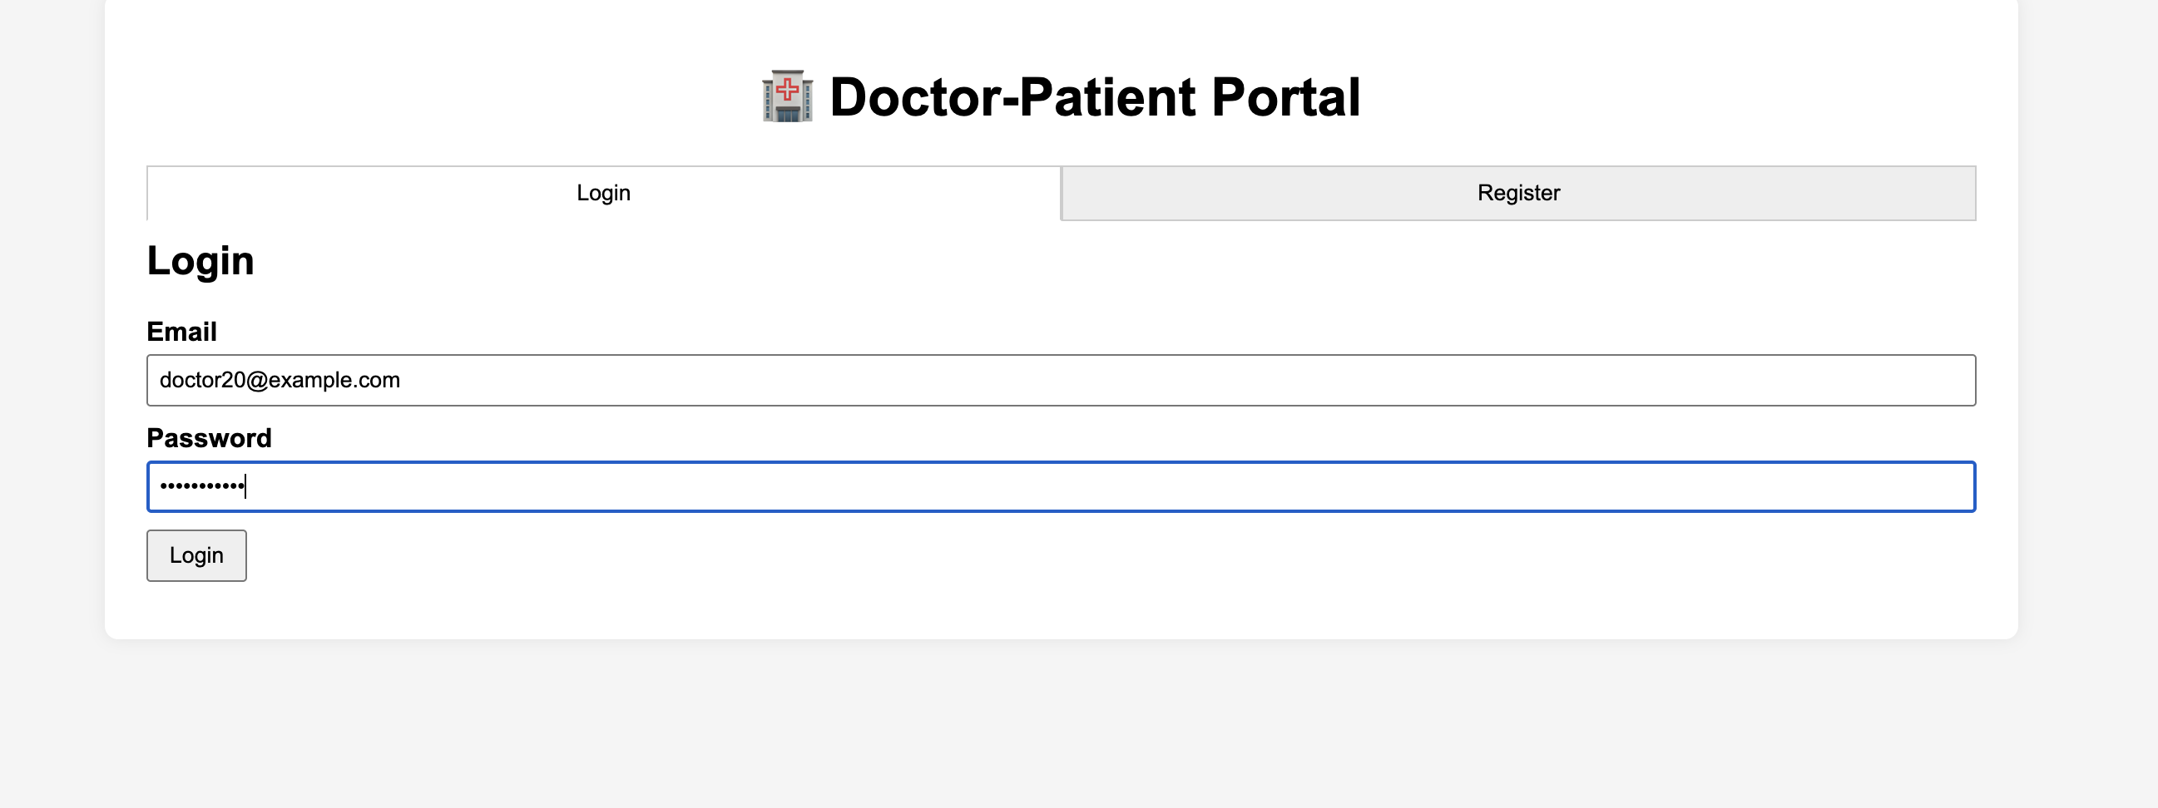
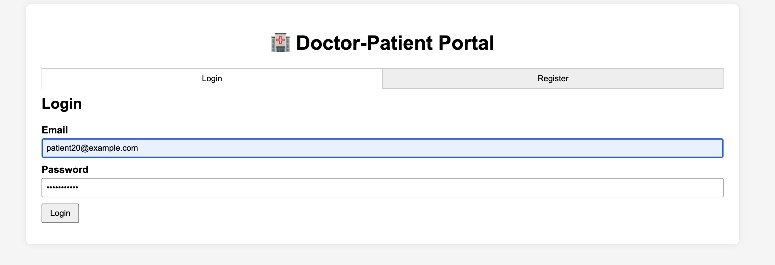
Login and Register Page
The initial webpage for users to login to the portal.

Slide 45
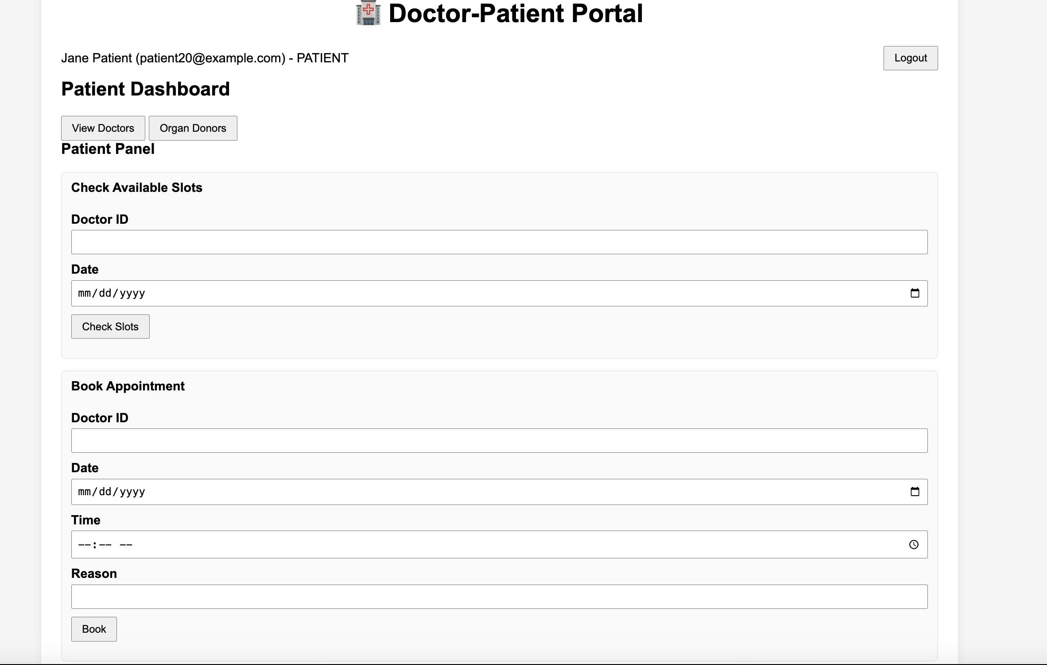
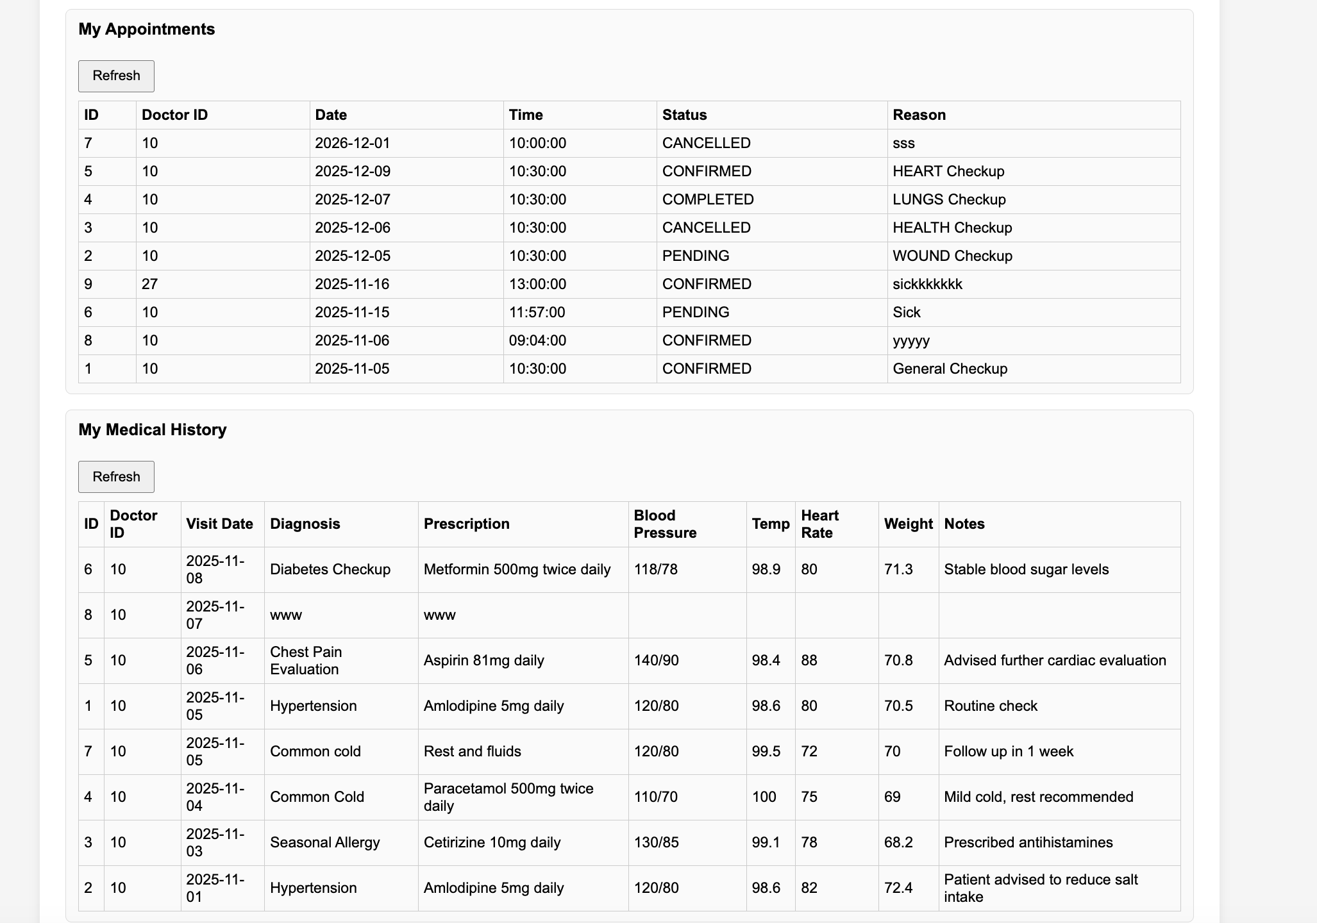
Patient Dashboard
From here, the patient can:
Check for available Doctors and dates
Set Appointments up with specific doctors.

Slide 46
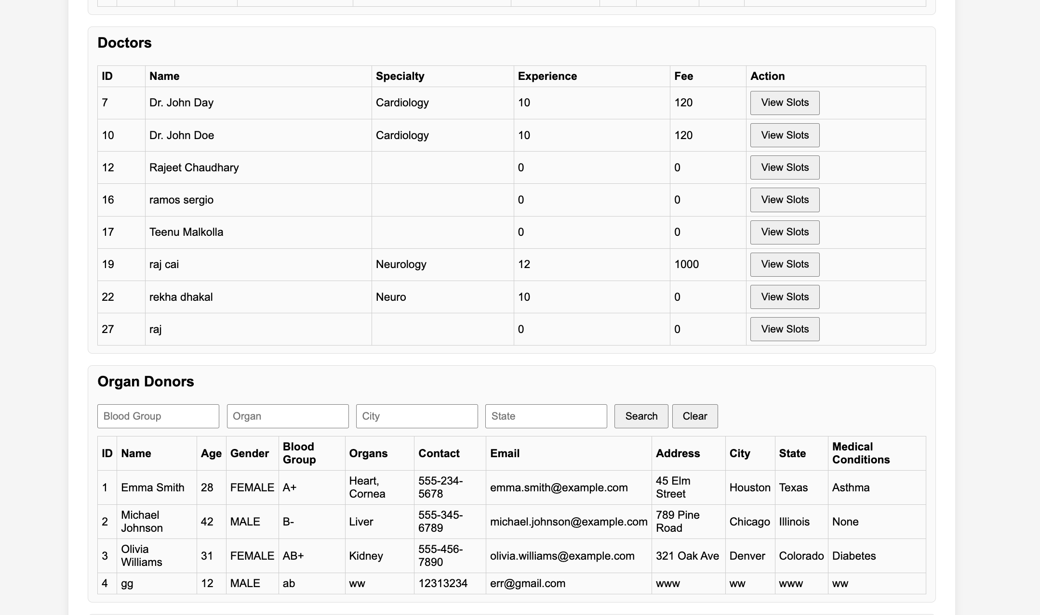
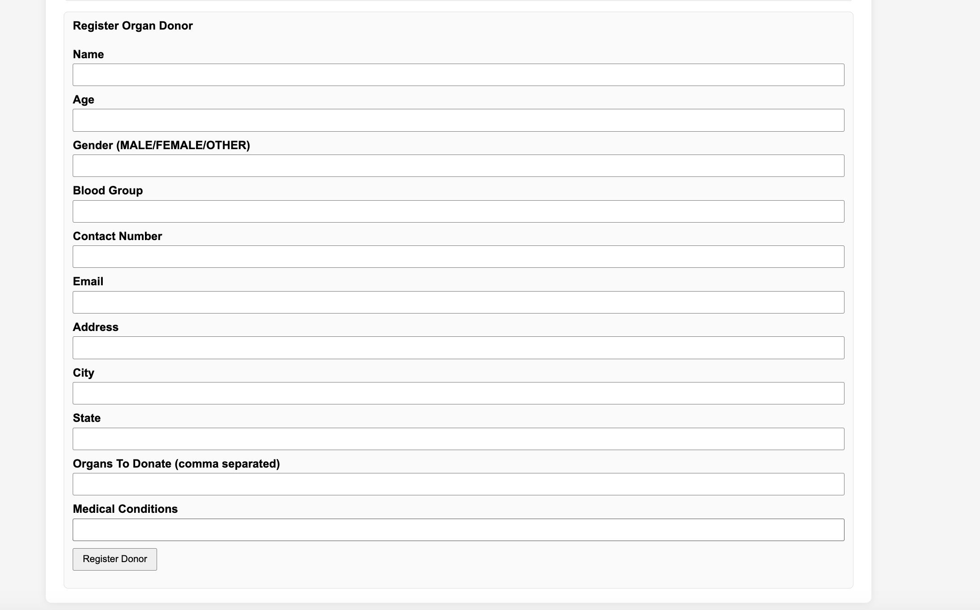
Patient Dashboard
Check on doctor information
View Organ Donors
Register Organ Doners

Slide 47
Doctor Dashboard

Slide 48
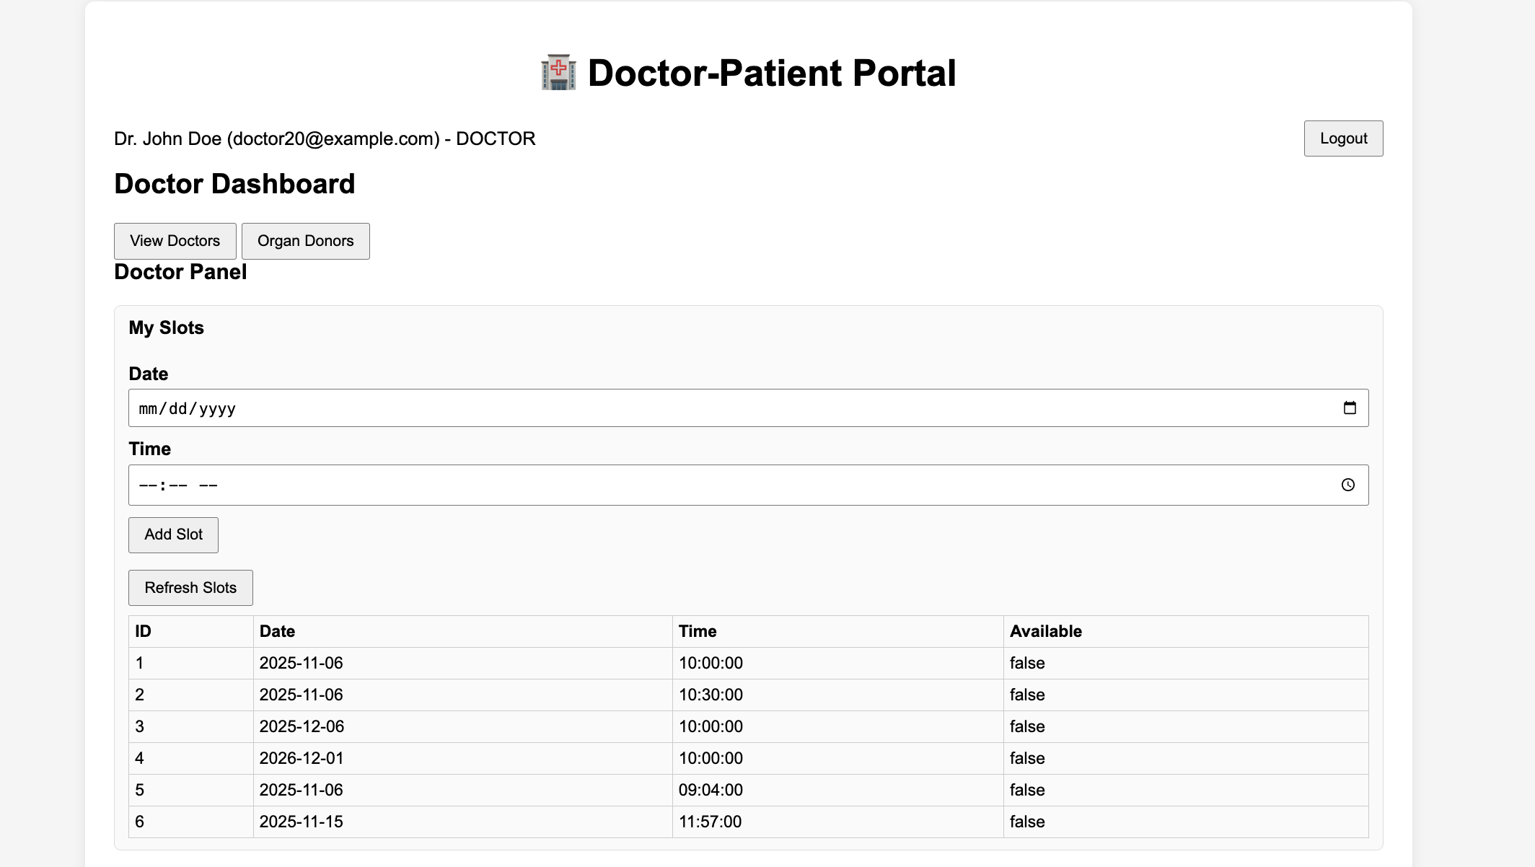
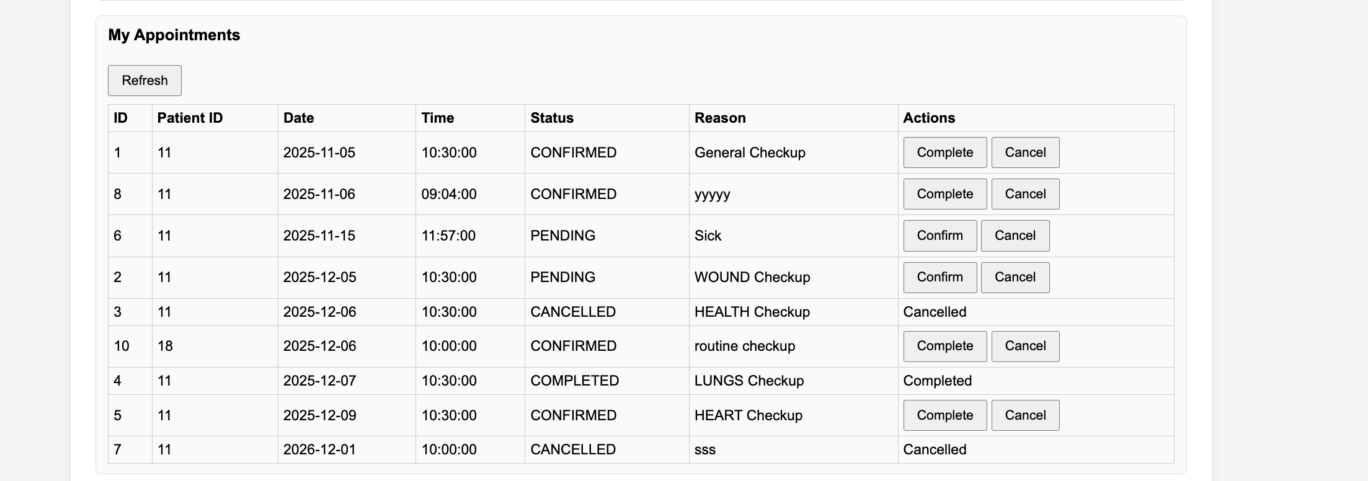
When a doctor accesses their personal account portal,
They will be able to check their schedule for availabilities
They can view their appointments and its details.

Slide 49
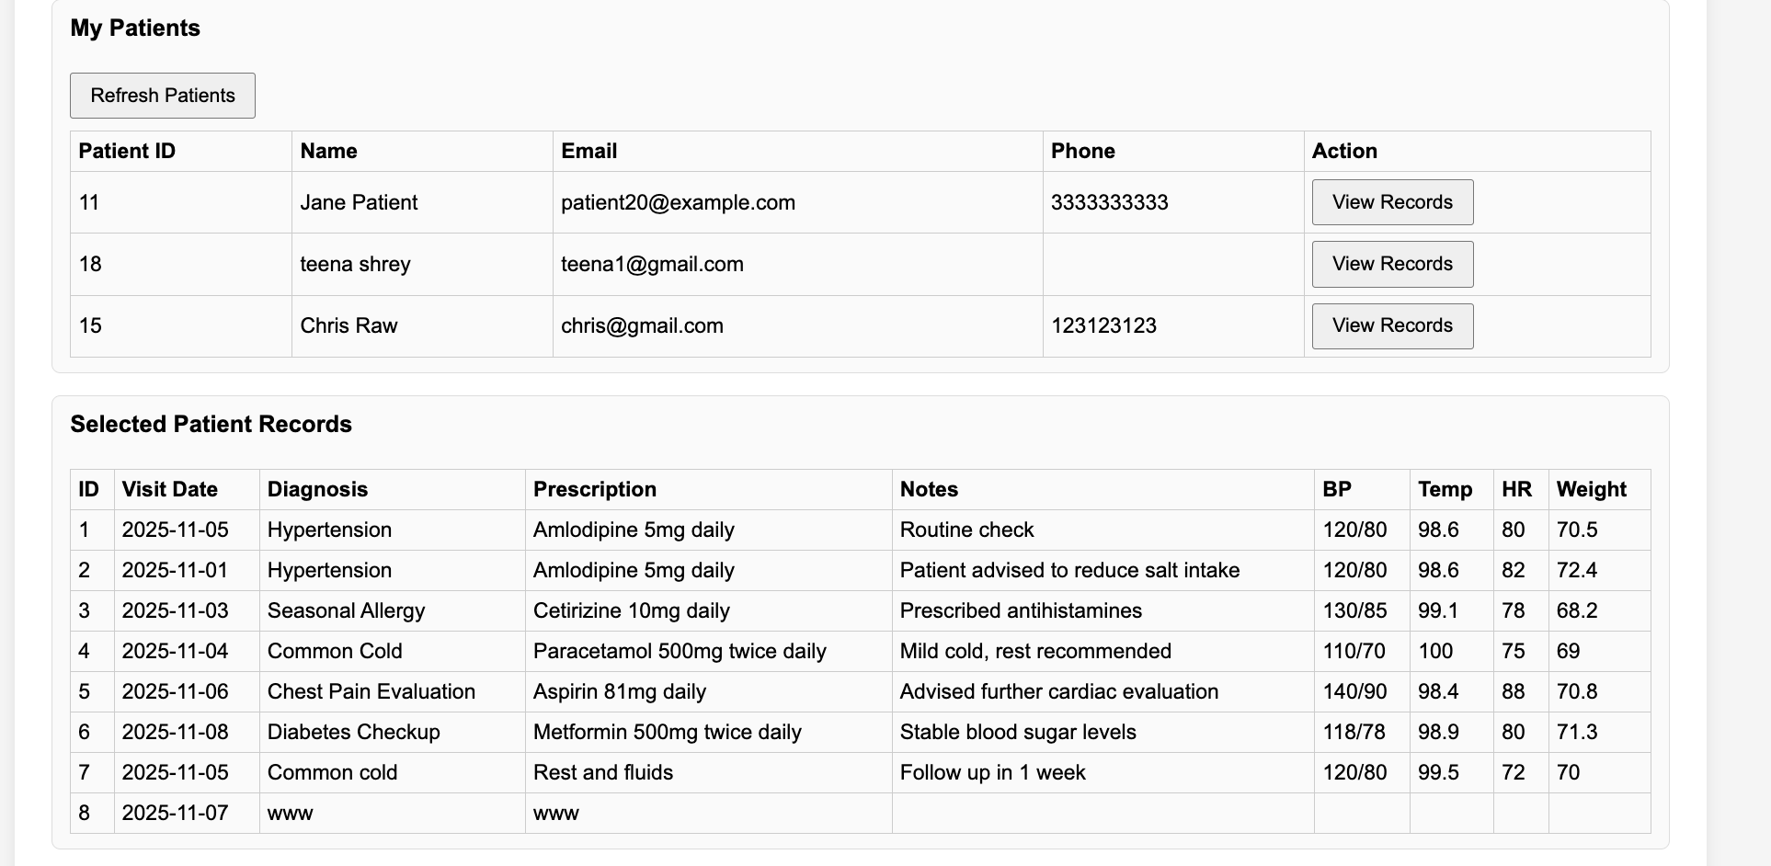
Patient View
The doctor will also be able to view patient information as well as patient records.

Slide 50
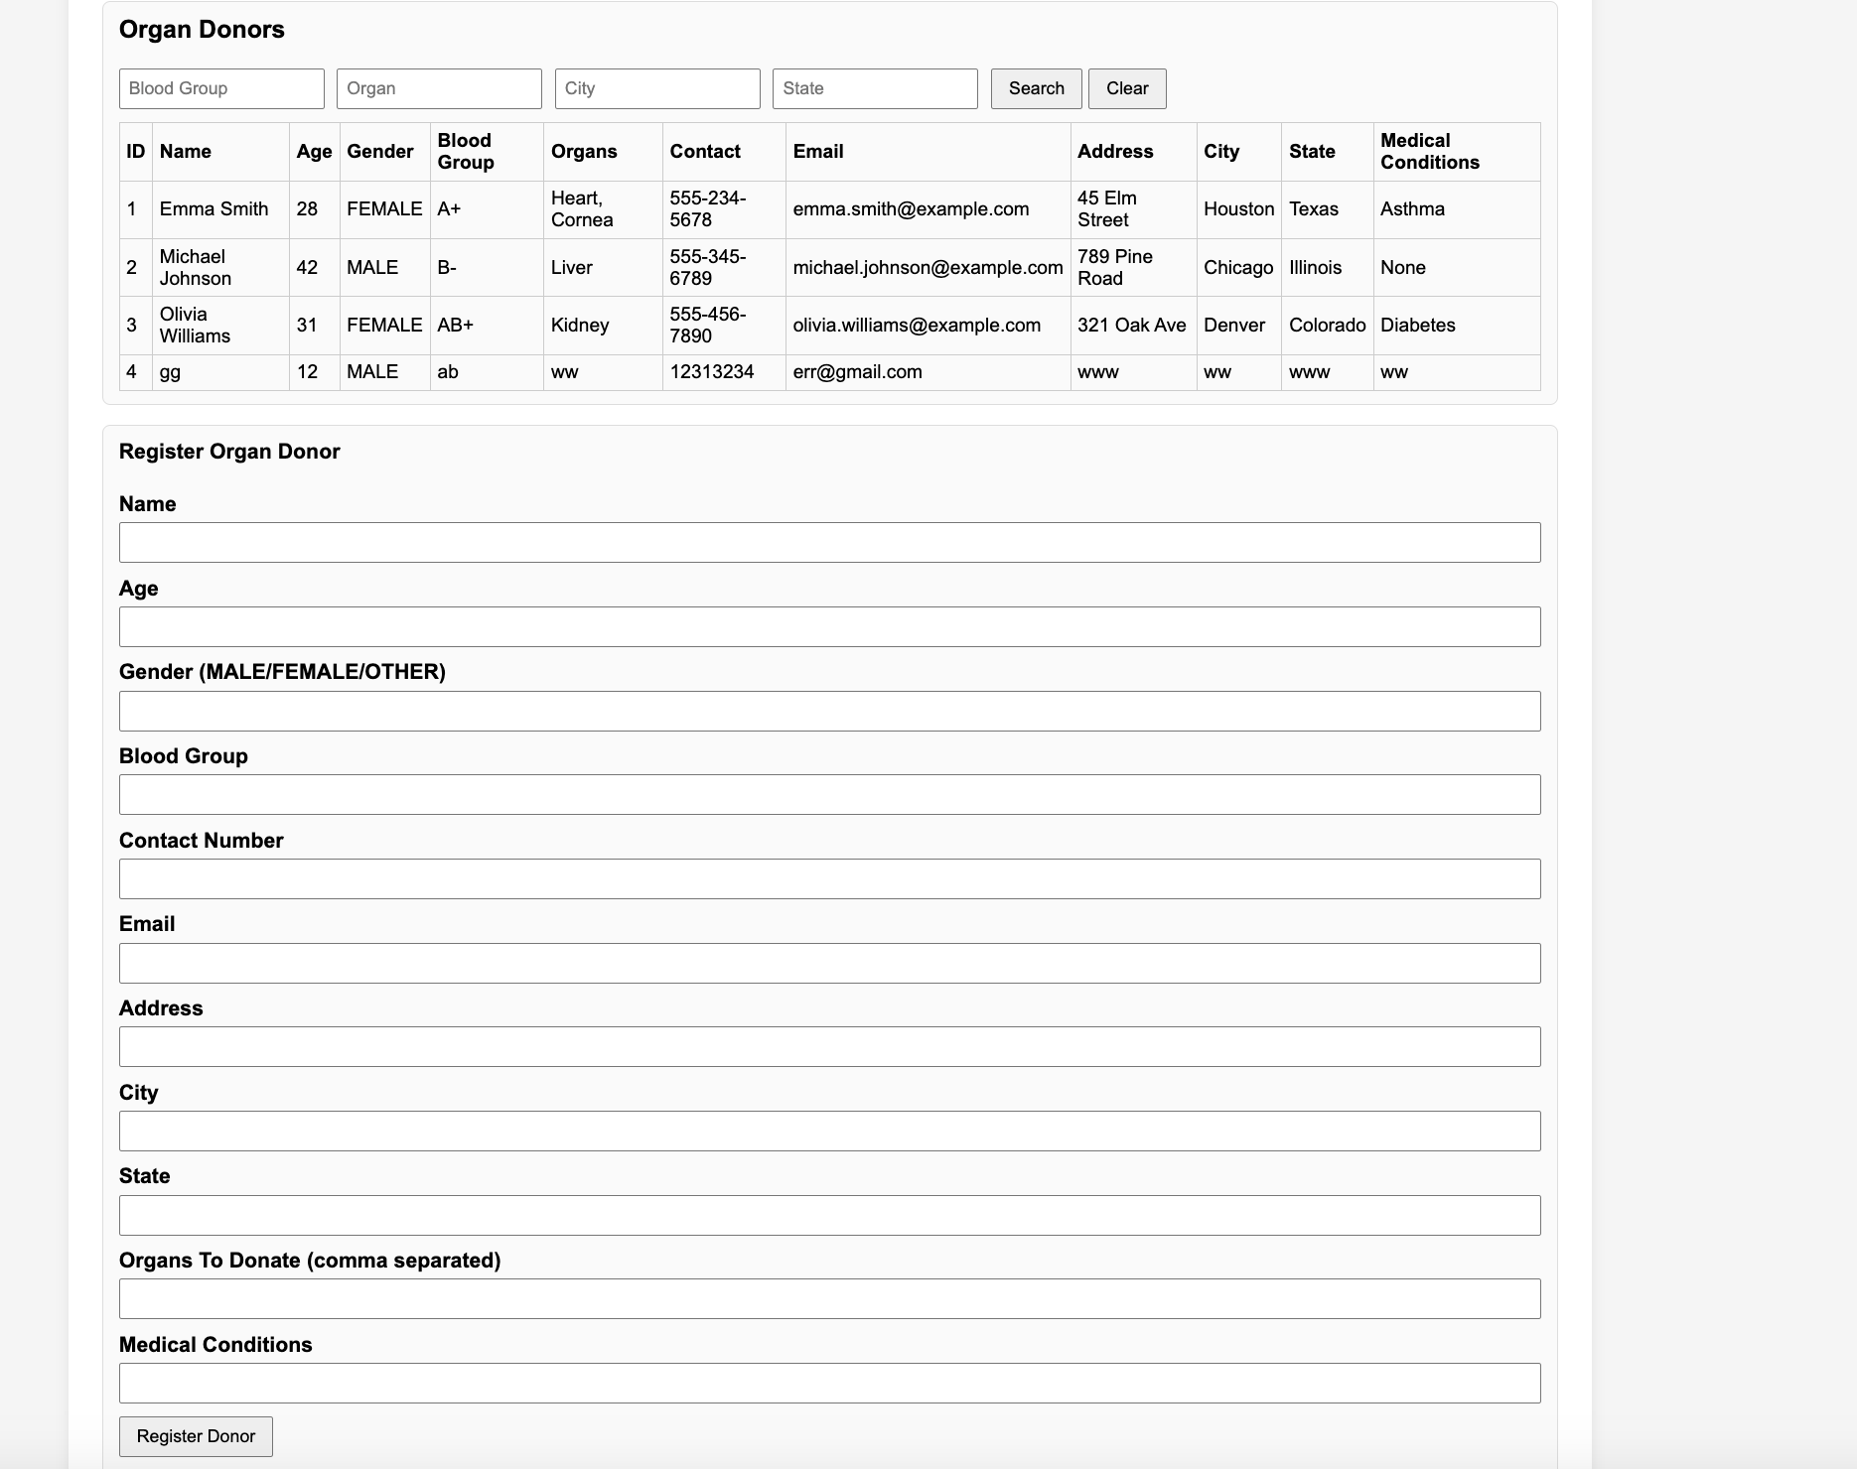
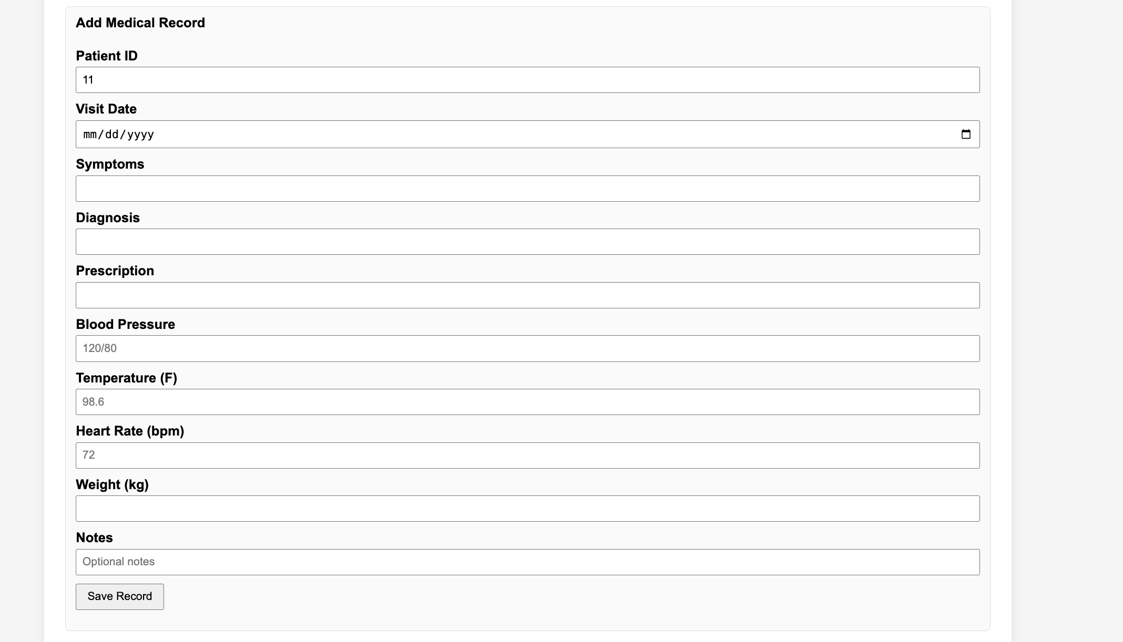
Medical and Organ Donor Records
From these pages, the Doctor will be able to register new Organ Donors, as well as add Medical Records to his database.

Slide 51

The End

